Slide 1
Introduction to CAN Protocol
AGENDA
What is CAN protocol
Why CAN protocol
Where is CAN protocol used
Compare CAN protocol to similar protocols
Shyam Bhat
VicharaVandana

Slide 2
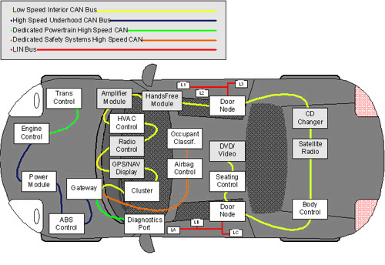
What is CAN?
Controller
Area
Network
Nodes
Network
ECUs
Speed
Length
Data

Slide 3
Why CAN?
Automotive Domain needed a way for all ECUs to communicate the data among themselves.
Communication could be started by any node –Asynchronous|Multimaster
Highly immune to electrical noise – Dual twisted pair
Short latency period – Small frame size (8bytes data)
Many more reasons

Slide 4
Comparing CAN with other protocols

